Slide 1
Stoichiometry of Gas-Liquid Reactions in Flow
Fabian Raymenants
Flow Chemistry Group
Van ‘t Hoff Institute for Molecular Sciences (HIMS)
University of Amsterdam (UvA)
Problem Set Meeting – February 10, 2022

Slide 2
Introduction

Slide 3
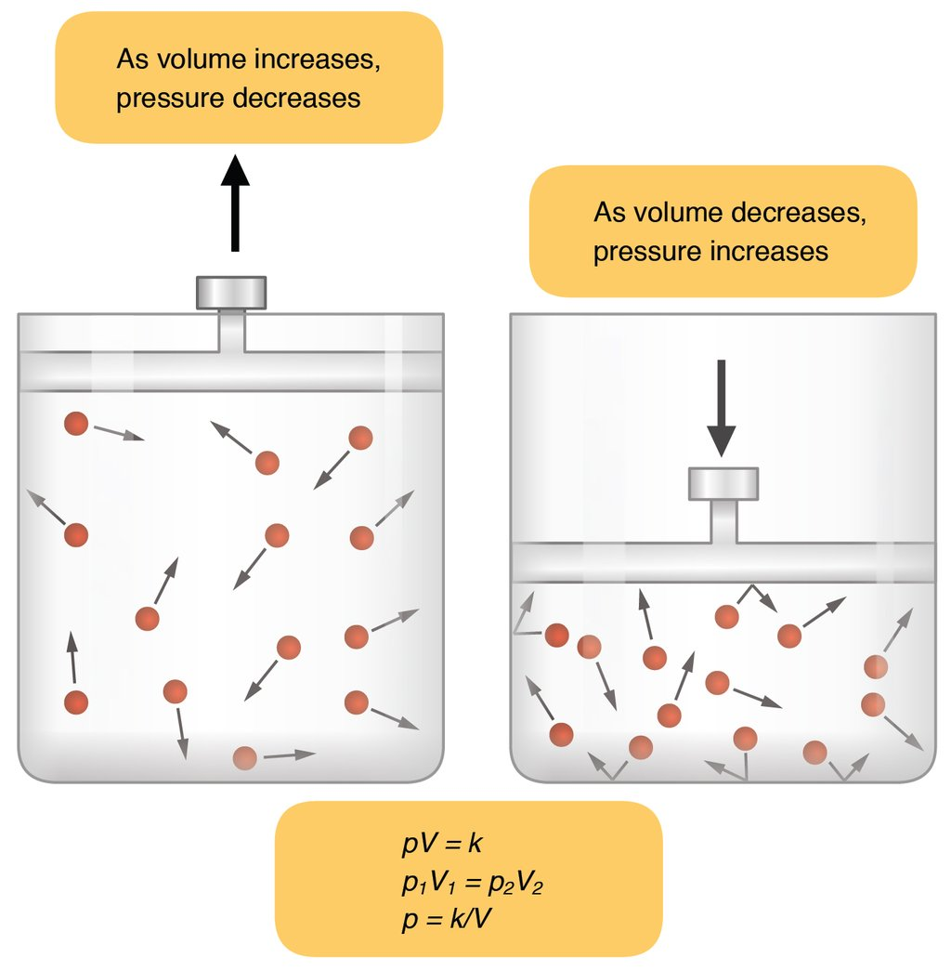
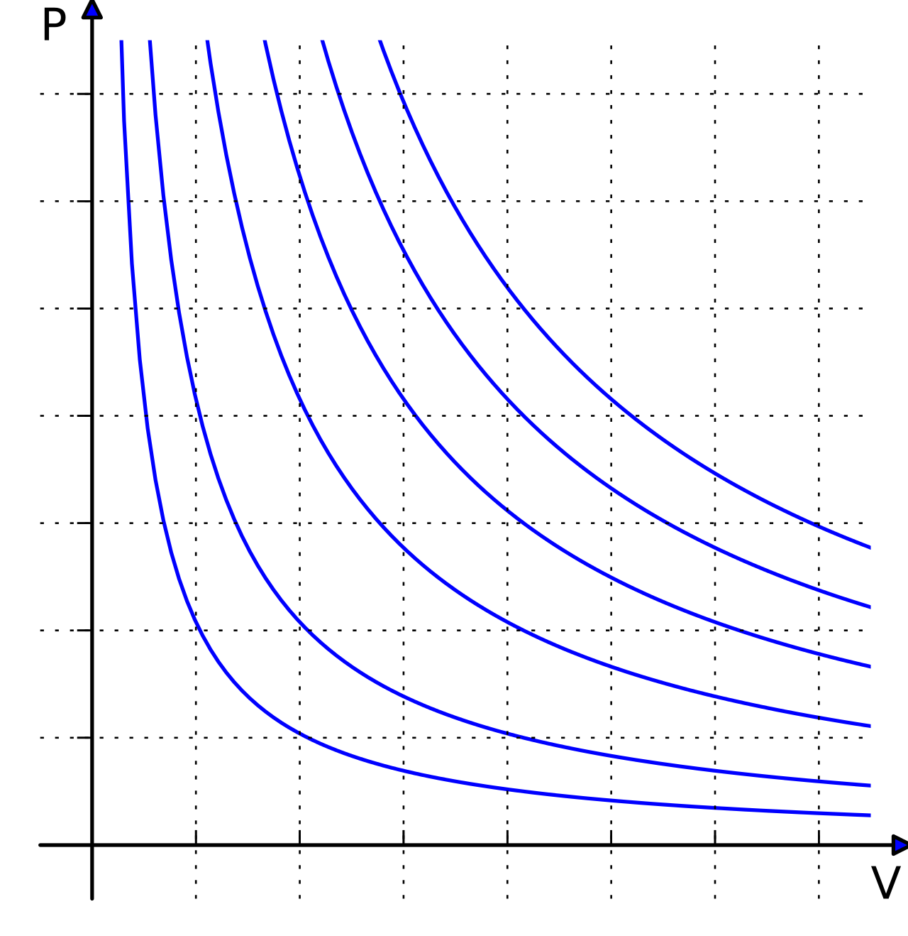
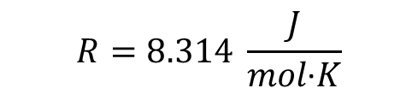


Gas laws
Ideal gas law: The equation of state of a hypothetical ideal gas.
It is a good approximation of the behavior of many gases under many conditions.
p-V isotherms
$$pV=nRT$$
$$\frac{p_{1}V_{1}}{T_{1}}=\frac{p_{2}V_{2}}{T_{2}}$$
T
$$R=8.314 \frac{J}{mol\text{∙}K}$$
As volume increases,
Pressure decreases
As volume decreases,
Pressure increases
Which lines represent higher T?

Slide 4
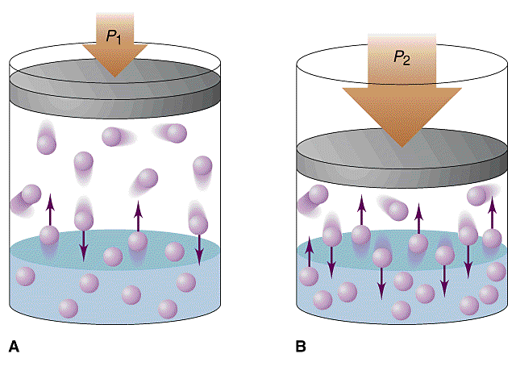
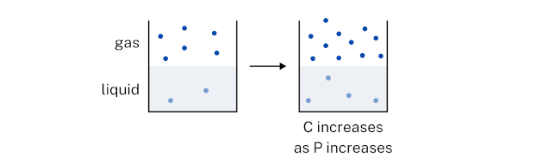
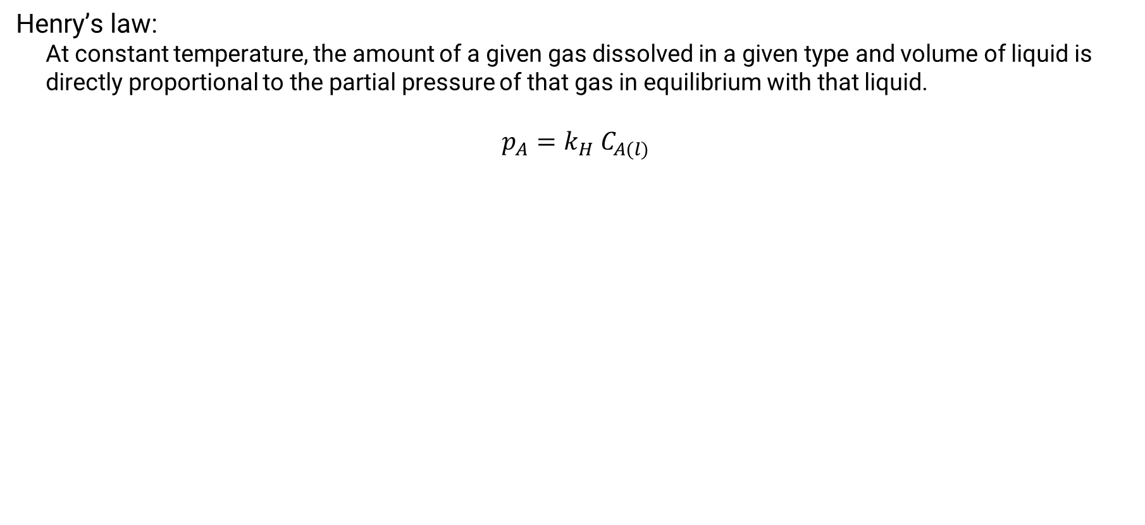
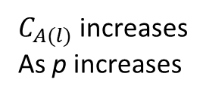
Gas laws
Henry’s law:
At constant temperature, the amount of a given gas dissolved in a given type and volume of liquid is directly proportional to the partial pressure of that gas in equilibrium with that liquid.
$$p_{A}=k_{H}{ C}_{A(l)}$$
$C_{A(l)}$ increases
As p increases

Slide 5
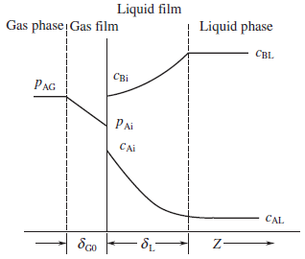
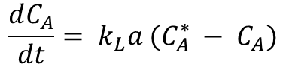
Two-film theory
Describes the mass transfer as molecular diffusion through a stagnant gas/liquid layer of thickness δ and the bulk gas/liquid is well mixed
Liquid
Gas
δ_{L}
$$\frac{dC_{A}}{dt}= k_{L}a (C_{A}^{∗} − C_{A})$$
With k_{L} the mass transfer rate of the gas on the liquid film
And a the interfacial area
Notes:
https://pubs.rsc.org/en/content/articlelanding/2020/re/c9re00390h

Slide 6
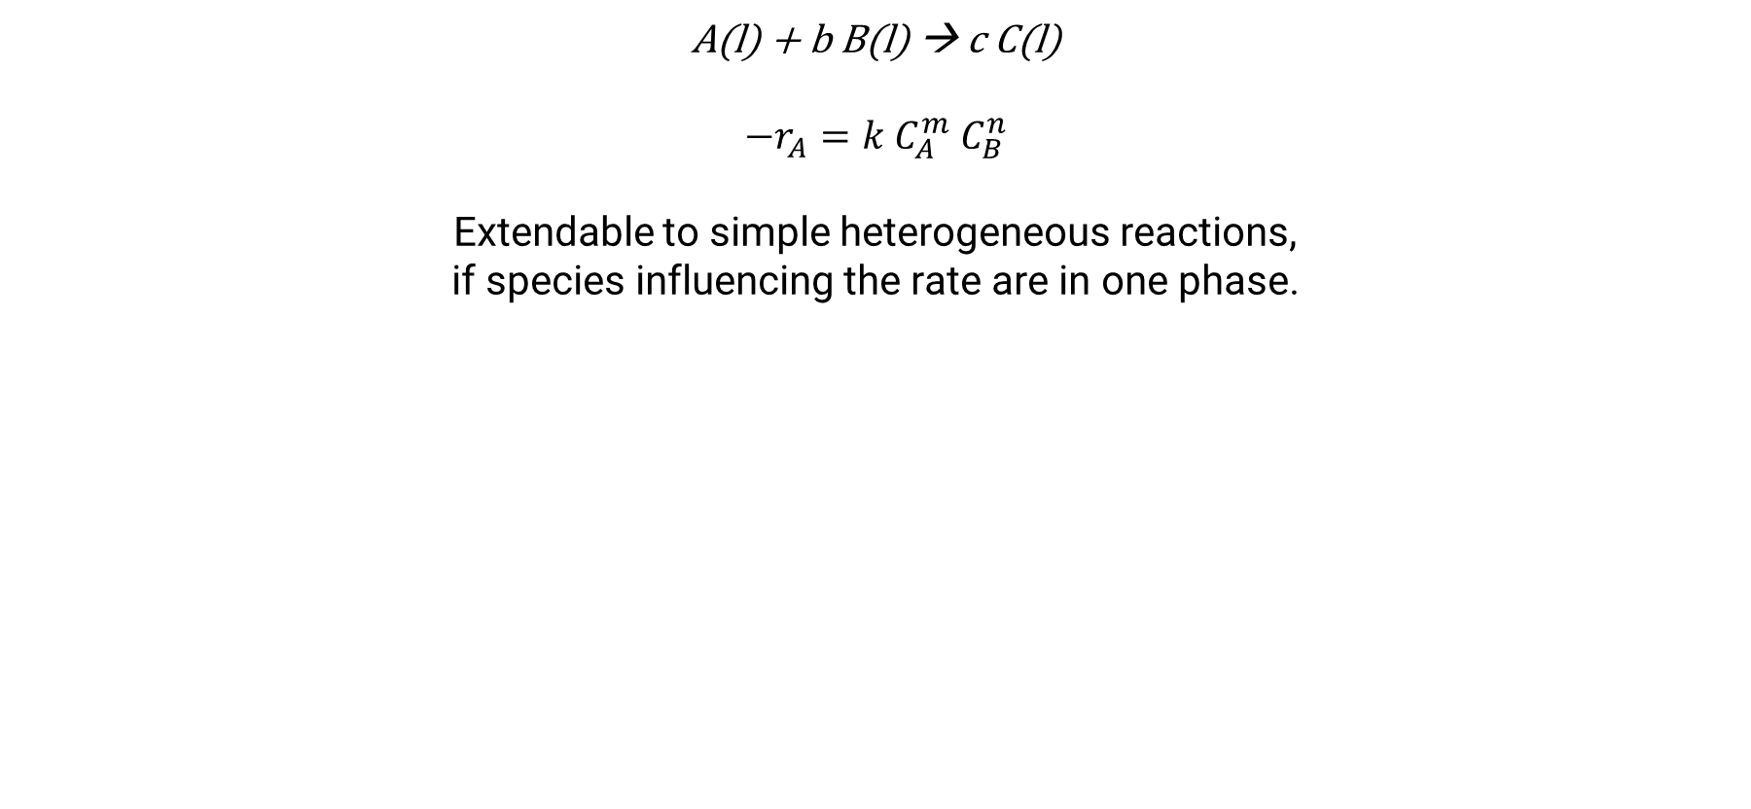
Kinetics of a reaction in a one-phase system
A(l) + b B(l) → c C(l)
$$−r_{A}=k C_{A}^{m} C_{B}^{n}$$
Extendable to simple heterogeneous reactions,
if species influencing the rate are in one phase.

Slide 7
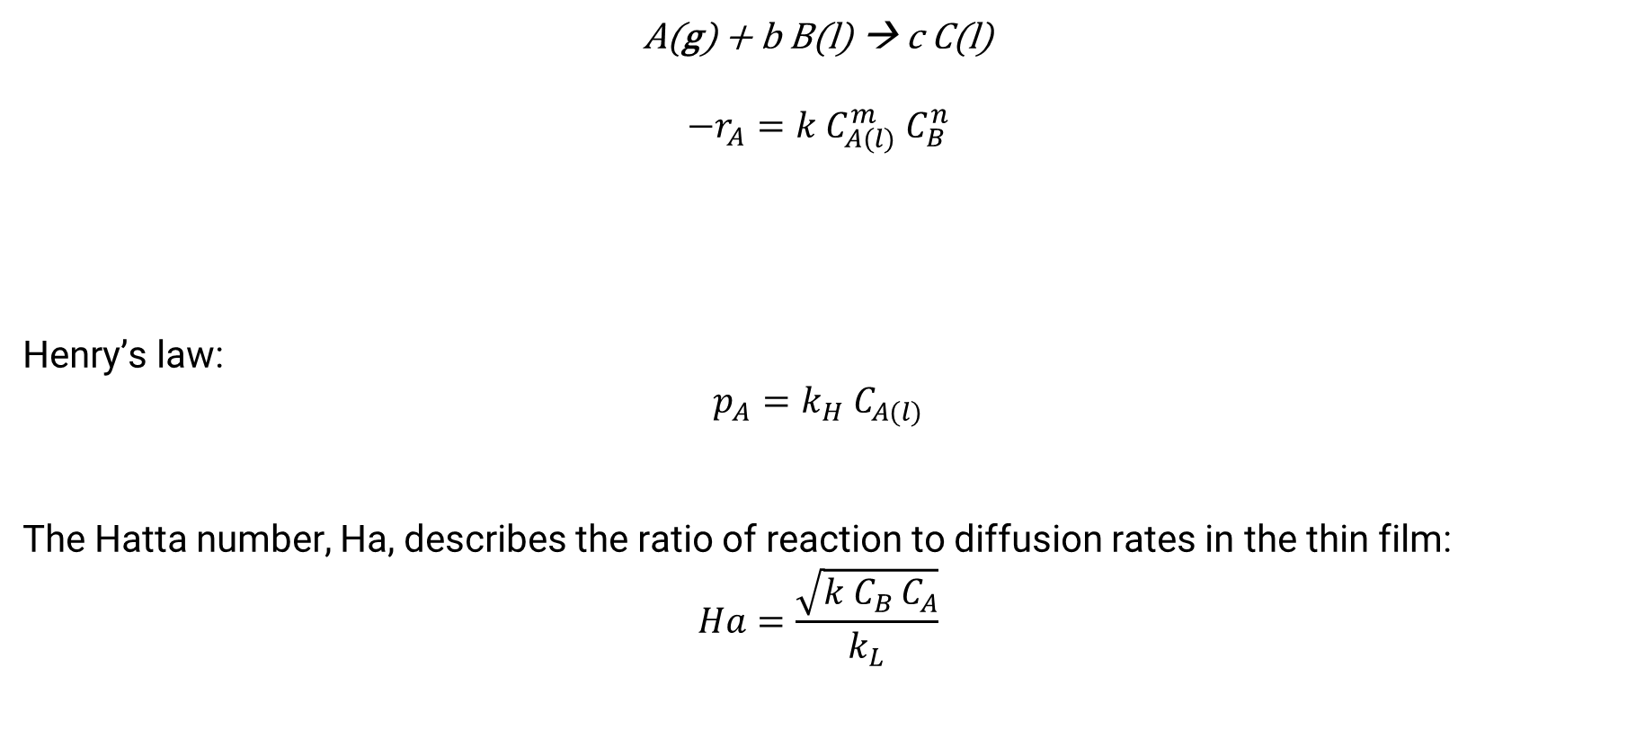
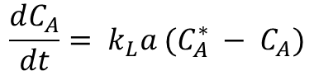
Kinetics in a gas-liquid system
A(g) + b B(l) → c C(l)
$$−r_{A}=k C_{A(l)}^{m} C_{B}^{n}$$
Henry’s law:
$$p_{A}=k_{H}{ C}_{A(l)}$$
The Hatta number, Ha, describes the ratio of reaction to diffusion rates in the thin film:
$$Ha=\frac{\sqrt{k C_{B }C_{A}}}{k_{L}}$$
$$\frac{dC_{A}}{dt}= k_{L}a (C_{A}^{∗} − C_{A})$$
Notes:
https://pubs.rsc.org/en/content/articlelanding/2020/re/c9re00390h

Slide 8

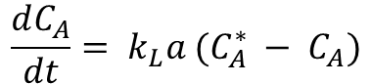
What methods can you think of to improve [gas]_{liquid phase}?
$$pV=nRT$$
$$p_{A}=k_{H}{ C}_{A(l)}$$
$$\frac{dC_{A}}{dt}= k_{L}a (C_{A}^{∗} − C_{A})$$
Increase p
Increase n
Lower T
Increase a
Other solvent for higher C*_{A} (= [A]_{saturation})
…

Slide 9
Gas-liquid Reactions in Flow

Slide 10
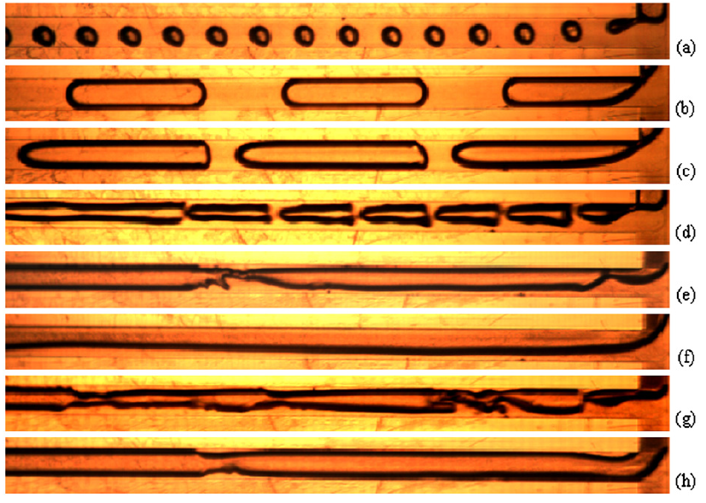
Gas flow regimes in a capillary reactor
Bubbly flow
Slug flow
Slug flow
Unstable slug flow
Slug-annular flow
Parallel flow
Churn flow
Annular flow

Slide 11
Method for G-L Reaction in Flow
Continuous G-L Reaction
Loop filling at lower p and pressurization
Limitation: Inlet liquid flow and inlet gas flow must be able to overcome reactor pressure (BPR design pressure + pressure drop of tubing).

Slide 12
Methods for G-L Reaction in Flow
Continuous G-L Reaction
Limitation: Inlet liquid flow and inlet gas flow must be able to overcome reactor pressure (BPR design pressure + pressure drop of tubing).

Slide 13
Methods for G-L Reaction in Flow
Loop filling at lower p and pressurization
Higher pressures can be achieved during reaction.

Slide 14
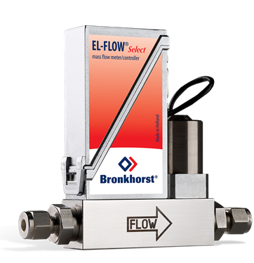
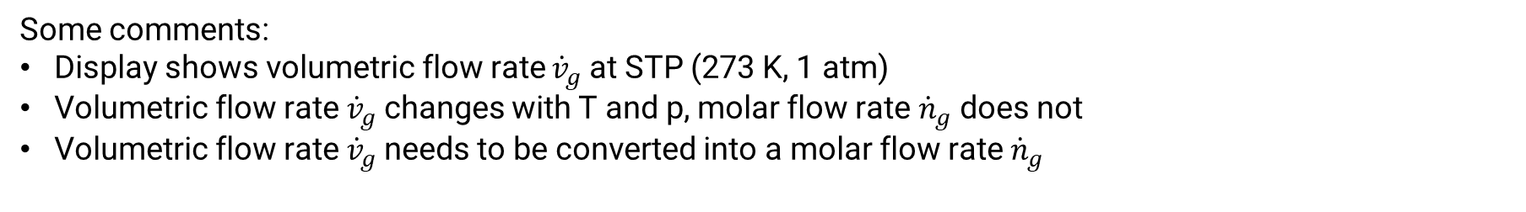
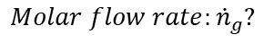
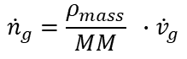
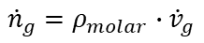
Mass Flow Controller
Some comments:
Display shows volumetric flow rate ${\dot{v}}_{g}$at STP (273 K, 1 atm)
Volumetric flow rate ${\dot{v}}_{g}$changes with T and p, molar flow rate ${\dot{n}}_{g}$ does not
Volumetric flow rate ${\dot{v}}_{g}$needs to be converted into a molar flow rate ${\dot{n}}_{g}$
$Molar flow rate:{\dot{n}}_{g}?$
$${\dot{n}}_{g}=ρ_{molar}∙{\dot{v}}_{g}$$
$${\dot{n}}_{g}={\frac{ρ_{mass}}{MM} }_{ }∙{\dot{v}}_{g}$$
Look up thermophysical properties online:
e.g. https://www.engineeringtoolbox.com/carbon-monoxide-density-specific-weight-temperature-pressure-d_2092.html

Slide 15
Exercises: Gas-liquid Reactions in Flow

Slide 16

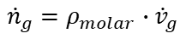
Loop filling method – G-L reactions in flow at high pressure
An Italian chemist performs a photochemical gas-liquid reaction with challenging light alkanes.
A loop filling method is used to combine gas- and liquid stream.
Reaction conditions and relevant physical properties are given in the table below.
Can you help him calculate the reaction stoichiometry (gas equivalents)?
 |  |  | Propane
Pressure | Loop filling | bar | 2.8
 | Reaction | bar | 7
Flow | Liquid | mL/min | 0.166
 | Gas applied | mL/min | 5
G:L ratio | At Ambient pressure | v/v% | 30.12
 | At Loop filling pressure | v/v% | …
 | At Reaction pressure | v/v% | …
Stoichiometry
 | Gas mass density | mg/mL | 1.796
 | MW gas | g/mol | 44.1
 | Gas molar density | mmol/mL
 | Gas flow | mmol/min
 | [Substrate] | mmol/mL | 0.1
 | Substrate flow | mmol/min
 | Gas eq | equiv. | ?
$Molar flow rate:{\dot{n}}_{g}?$
$${\dot{n}}_{g}=ρ_{molar}∙{\dot{v}}_{g}$$
$${\dot{n}}_{g}={\frac{ρ_{mass}}{MM} }_{ }∙{\dot{v}}_{g}$$

Slide 17
Loop filling method – G-L reactions in flow at high pressure
If a stock solution of 0.5 mmol in 5 mL CH₃CN is combined with the above calculated propane equivalents, what is the volume of the gas liquid mixture at liquefaction point?
At 298 K, the mass density of liquid propane is 0.493 g/mL.
 |  |  | Propane
Pressure | Loop filling | bar | 2.8
 | Reaction | bar | 7
Flow | Combined | mL/min
 | Liquid | mL/min | 0.166
 | Gas applied | mL/min | 5
G:L ratio | At Ambient pressure | v/v% | 30.12
 | At Loop filling pressure | v/v% | 10.76
 | During Reaction | v/v% | 4.3
Stoichiometry
 | Gas mass density | mg/mL | 1.796
 | MW gas | g/mol | 44.1
 | Gas molar density | mmol/mL | 0.04073
 | Gas flow | mmol/min | 0.204
 | [Substrate] | mmol/mL | 0.1
 | Substrate flow | mmol/min | 0.0166
 | Gas eq | equiv. | 12.27
Liquefaction
 | Loop filling time | min
 | Volume of gaseous alkane | mL
 | Mass of alkane | mg
 | Density as liquid (T 300K) | g/mL | 0.493
 | Volume of liquid alkane | uL

Slide 18
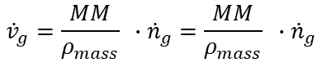
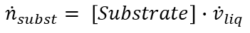
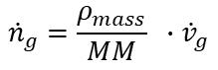
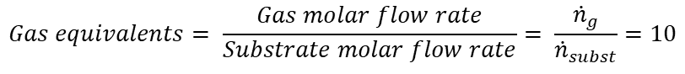
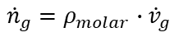
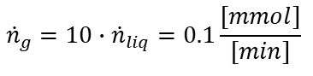
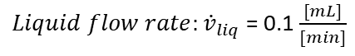
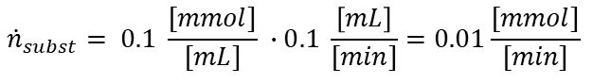
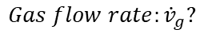
Loop filling method – G-L reactions in flow at high pressure
Another researcher of the NRG wants to use exactly 10 equivalents of alkane (isobutane) in a G-G-L reaction. A liquid flow rate of 0.1 mL/min is chosen for loop filling. Calculate the required gas flow rate by applying the following formulas:
$$Gas equivalents= \frac{Gas molar flow rate}{Substrate molar flow rate}= \frac{{\dot{n}}_{g}}{{\dot{n}}_{subst}}=10$$
Desired | Gas equivalents | 10
Substrate | Liquid flow rate | 0.1 | mL/min
 | [Substrate] | 0.1 | mmol/mL
 | Molar flow rate | 0.01 | mmol/min
$Liquid flow rate:{\dot{v}}_{liq}$ = 0.1 $\frac{[mL]}{[min]}$
$${\dot{n}}_{subst}= \left[Substrate\right]∙{\dot{v}}_{liq}$$
Isobutane | Molar flow rate |  | mmol/min
 | Molar mass | 58.124 | mg/mmol
 | Mass density (atm, 300 K) | 2.51 | mg/mL
 | Molar density |  | mmol/mL
 | Gas flow rate |  | mL/min
$${\dot{n}}_{subst}= 0.1 \frac{[mmol]}{[mL]} ∙0.1 \frac{\left[mL\right]}{[min]}=0.01\frac{[mmol]}{[min]}$$
$Gas flow rate:{\dot{v}}_{g}?$
$${\dot{n}}_{g}=10∙{\dot{n}}_{liq}=0.1\frac{[mmol]}{[min]}$$
$${\dot{n}}_{g}=ρ_{molar}∙{\dot{v}}_{g}$$
$${\dot{n}}_{g}={\frac{ρ_{mass}}{MM} }_{ }∙{\dot{v}}_{g}$$
$${\dot{v}}_{g}={\frac{MM}{ρ_{mass}} }_{ }∙{\dot{n}}_{g}={\frac{MM}{ρ_{mass}} }_{ }∙{\dot{n}}_{g}$$

Slide 19
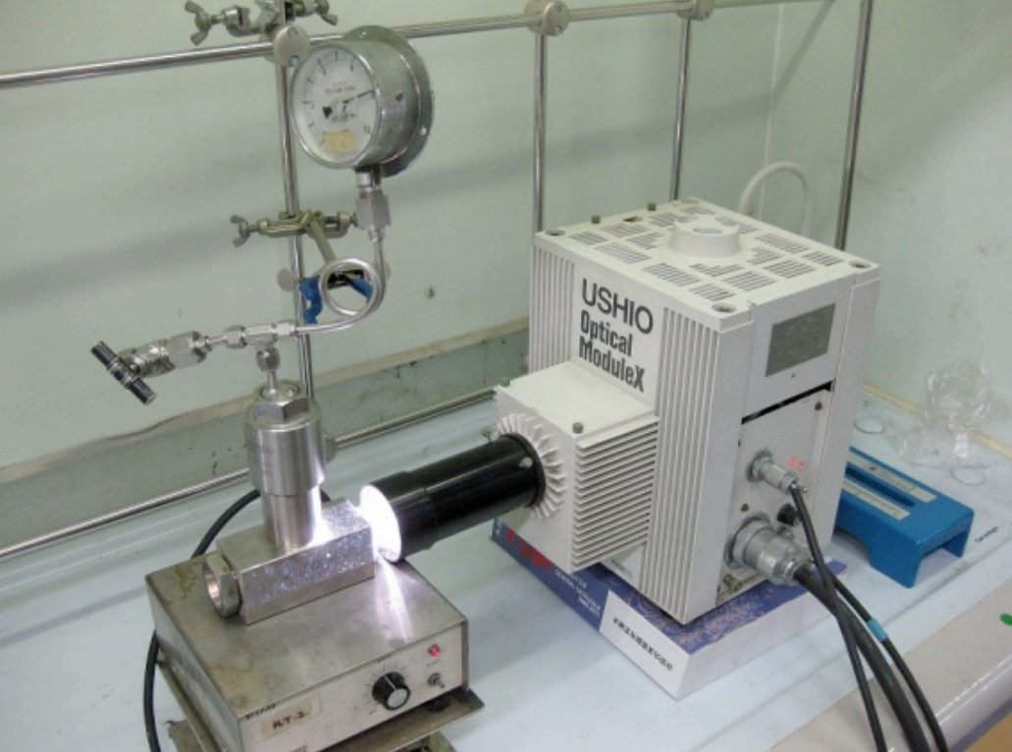
Technological improvement – Increased gas-liquid contact
Calculate the G-L contact area inside a 5 mL capillary vs. 5 mL batch reactor.
Assume no thin film, straight G-L surfaces in the capillary tube.
995 cm
Liquid
Gas
0.8 mm
G-L slug
2.54 cm
1 cm
Batch
V_{R} = 5 mL
I.D. = 2 cm
a_{batch} = ?
Flow
V_{R} = 5 mL
I.D. = 0.8 mm
a_{flow} = ?
Number of G-L slugs = 995/3.54 = 281
Number of G-L surfaces = 281 * 2 = 562
A_{slug} = π * (I.D.)² / 4 = π * (0.8)² / 4 = 0.5026 mm²
a_{flow} = 562 * 0.5026 mm² = 2.82 cm²
a_{batch} = π * (I.D.)² / 4 = π * (2)² / 4 = 3.14 cm²
→ Under these assumptions, still a larger GL surface area in batch than in flow.

Slide 20
Continuous slug flow – G-L reactions in flow at low pressures
Questions:
For a given stoichiometry and residence time. Calculate the required gas and liquid flow rates at atm.
Calculate with a 7 bar BPR and a capillary pressure drop of 4 bar.

Slide 21
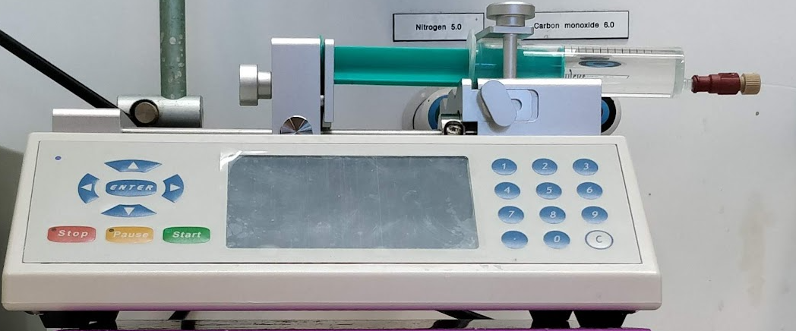
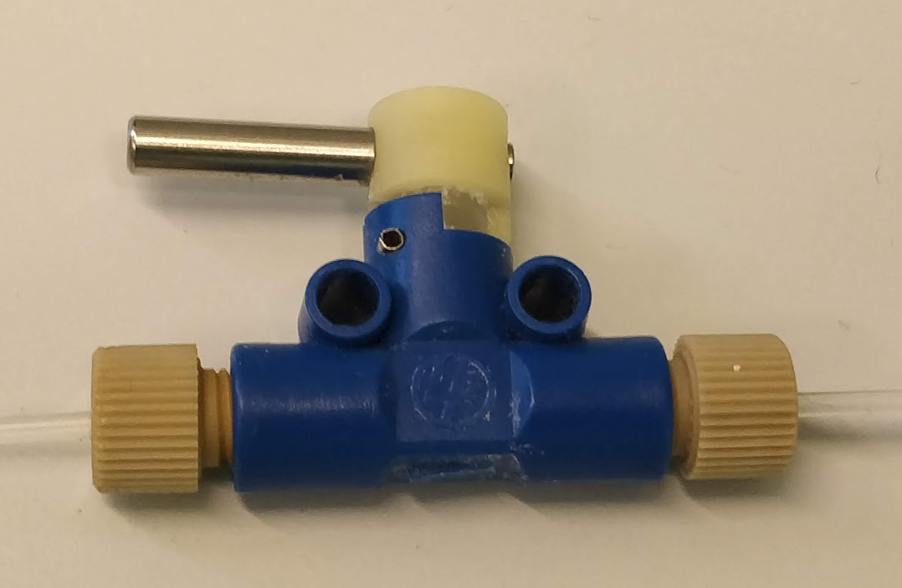
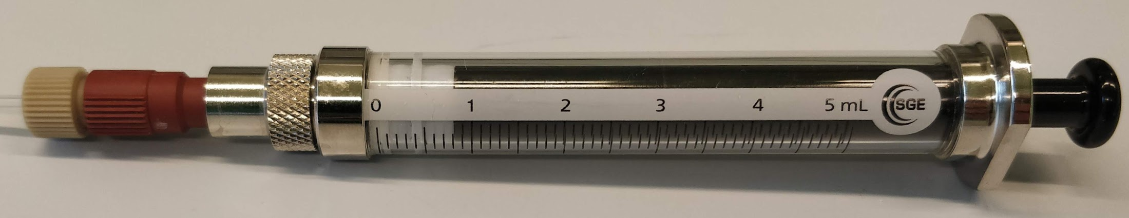
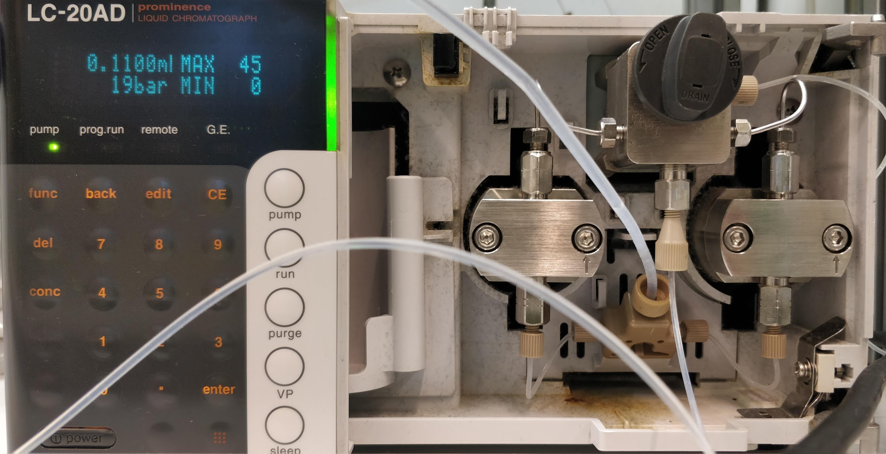
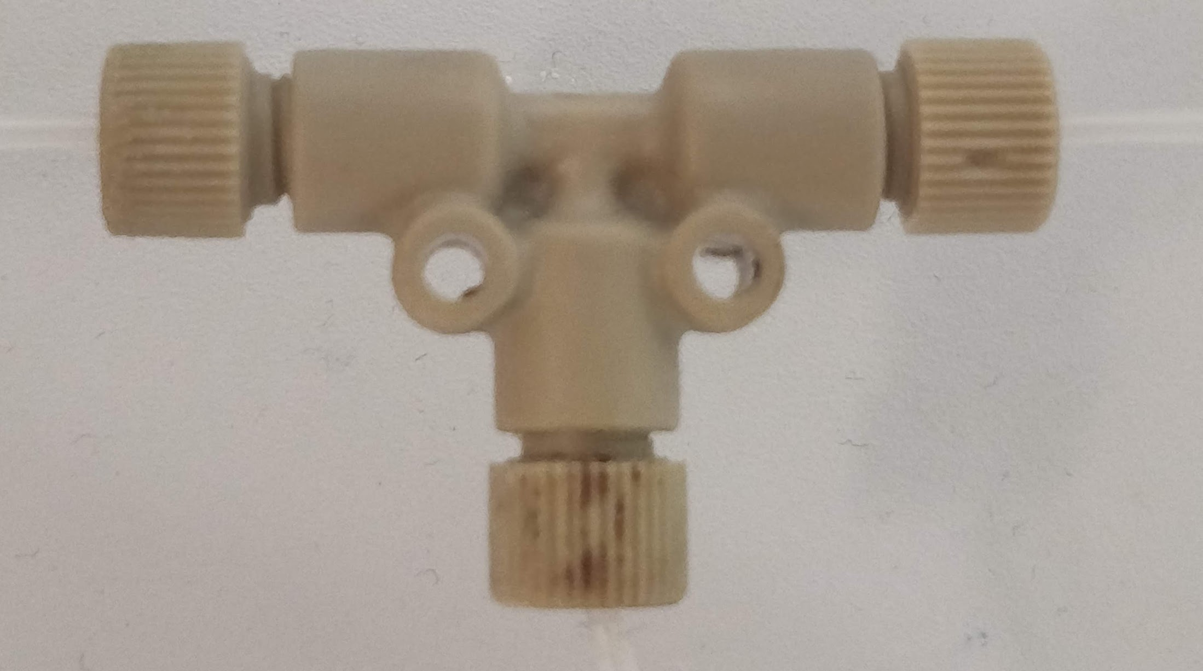
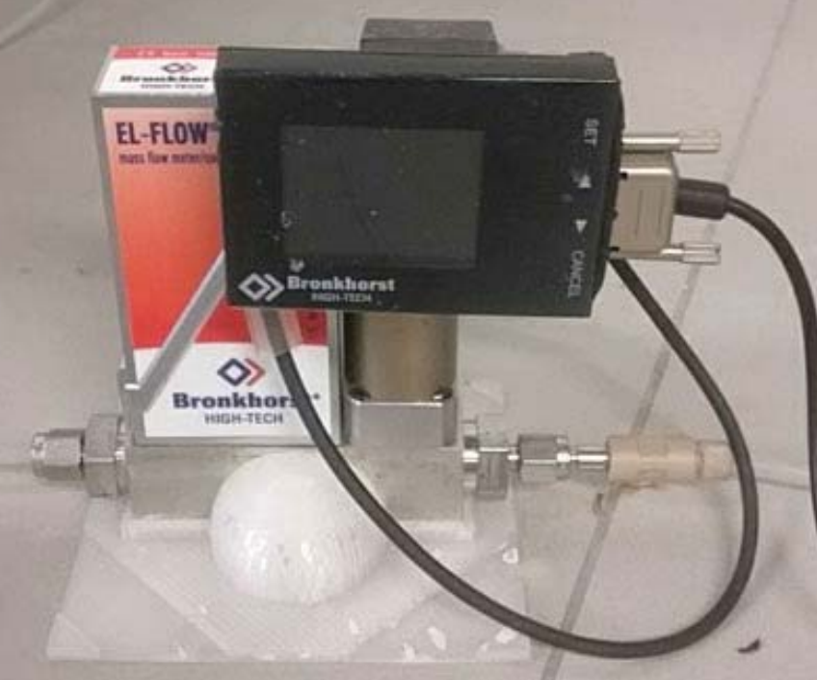
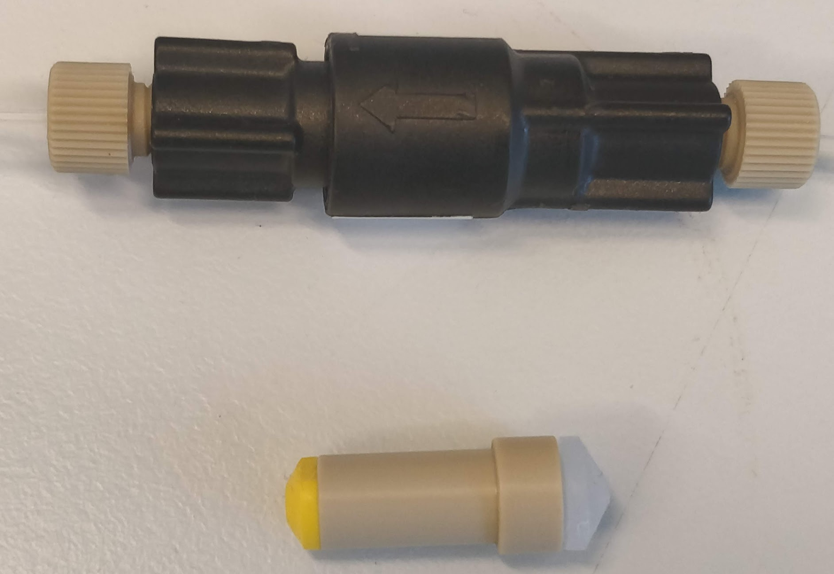
Equipment used for G-L reactions in flow
See pictures Science paper and oxidation paper

Slide 22
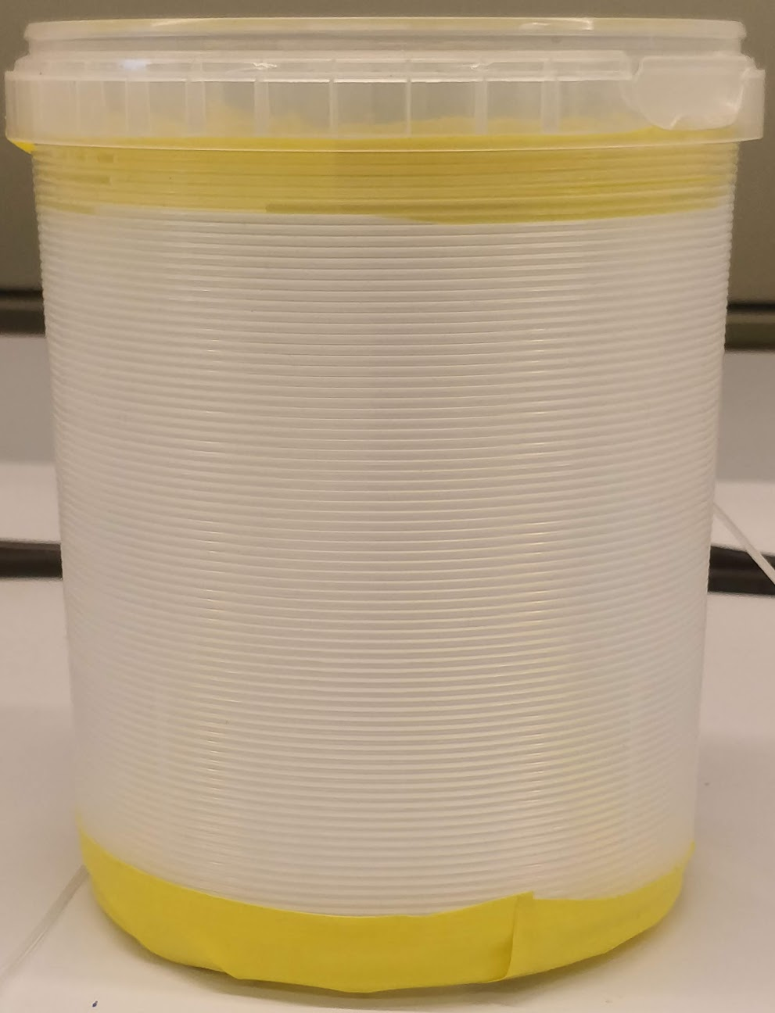
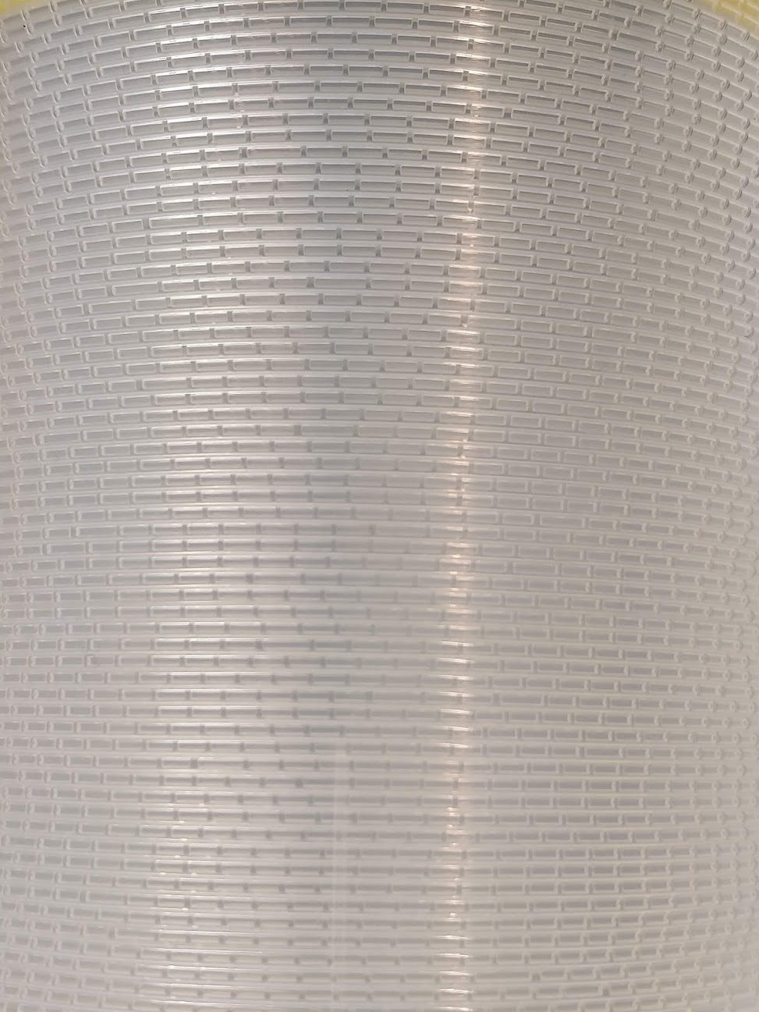
Equipment used for G-L reactions in flow
See pictures Science paper and oxidation paper

Slide 23
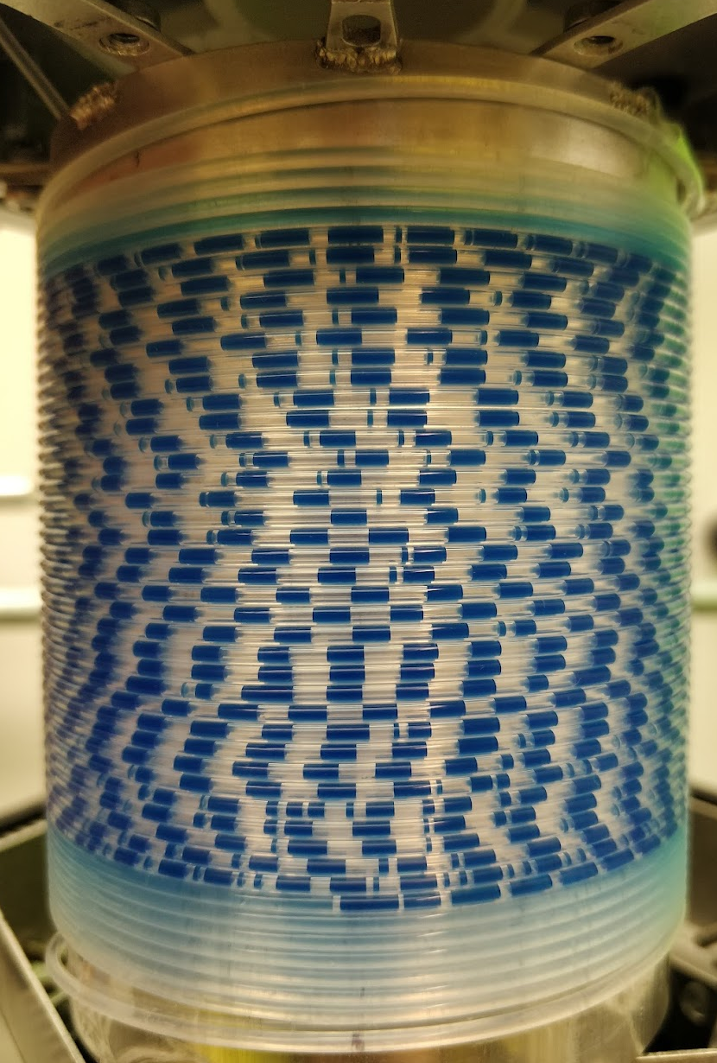
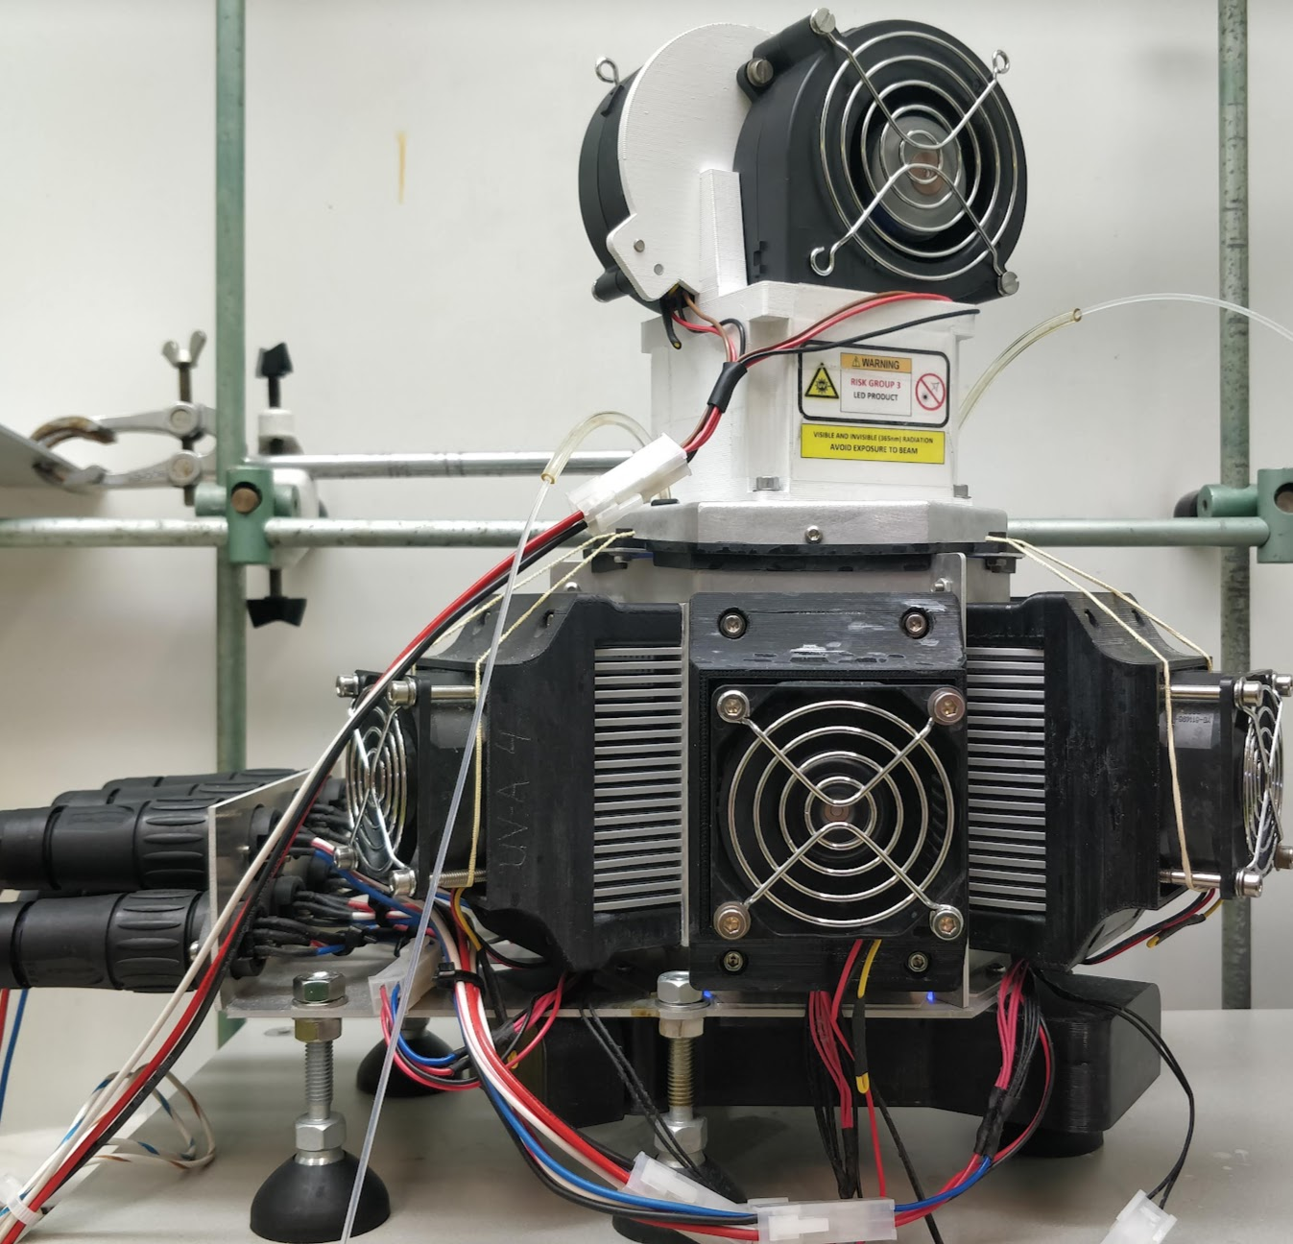
Equipment used for G-L reactions in flow
See pictures Science paper and oxidation paper

Slide 24
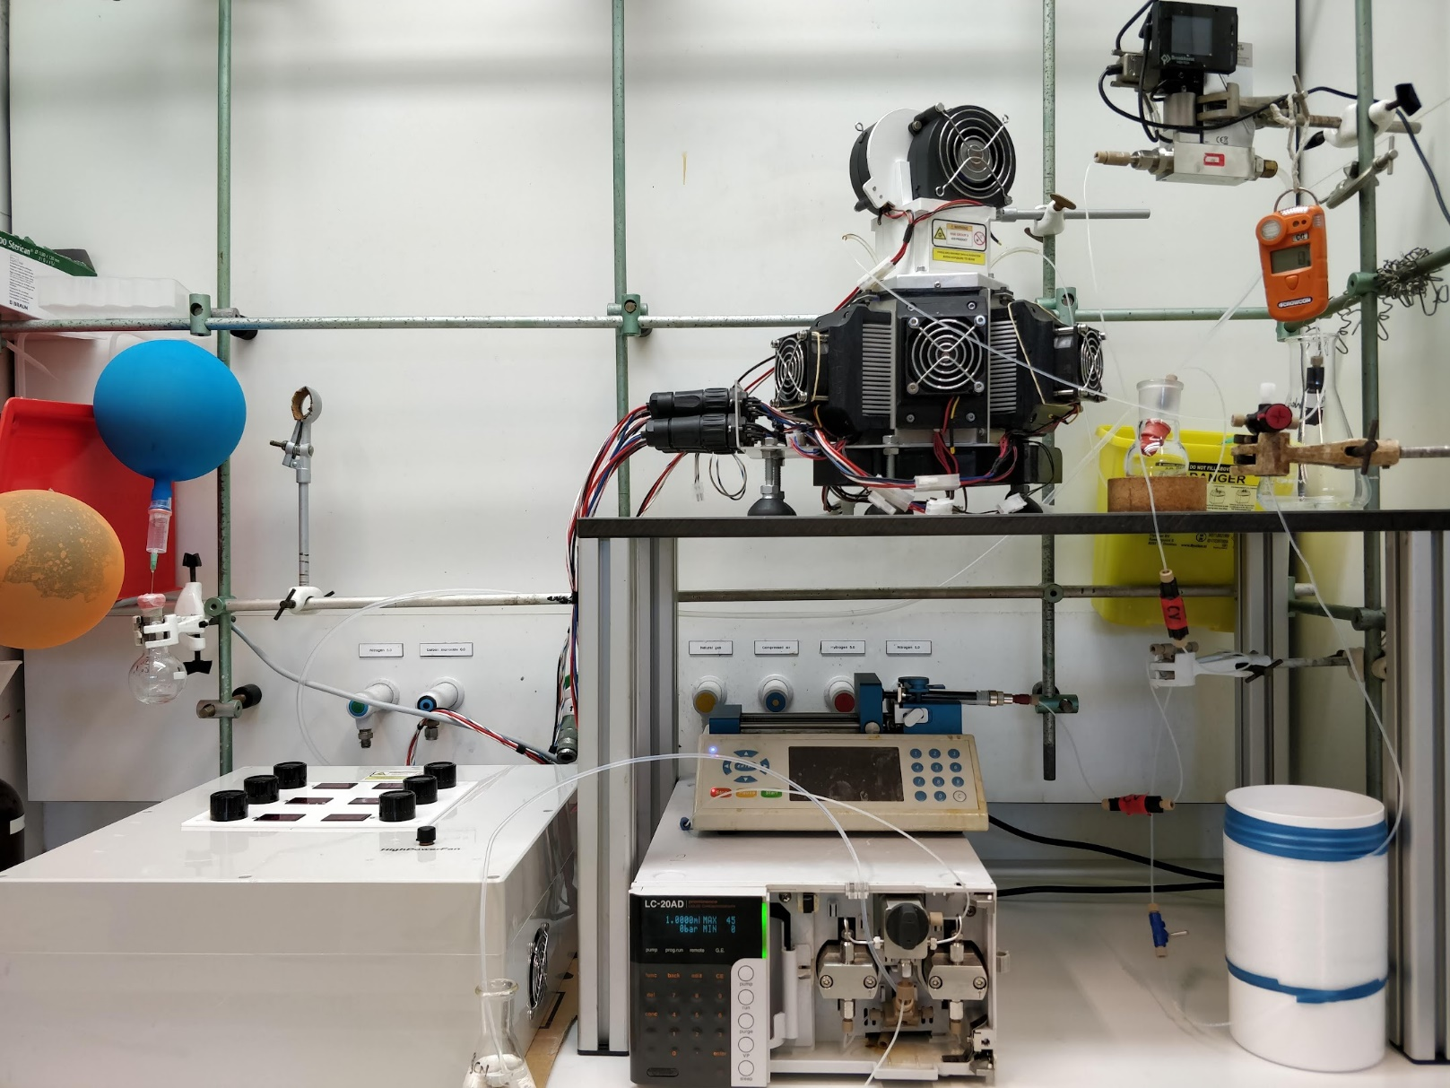
Equipment used for G-L reactions in flow
See pictures Science paper and oxidation paper

Slide 26
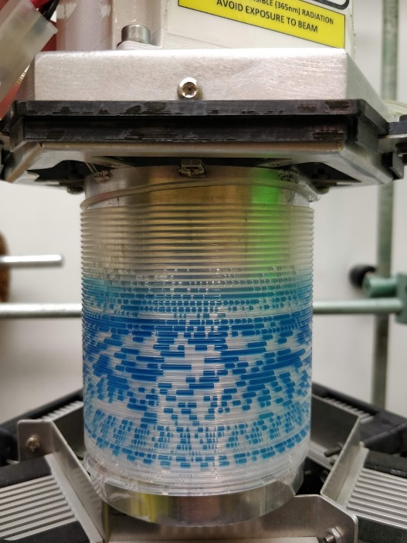
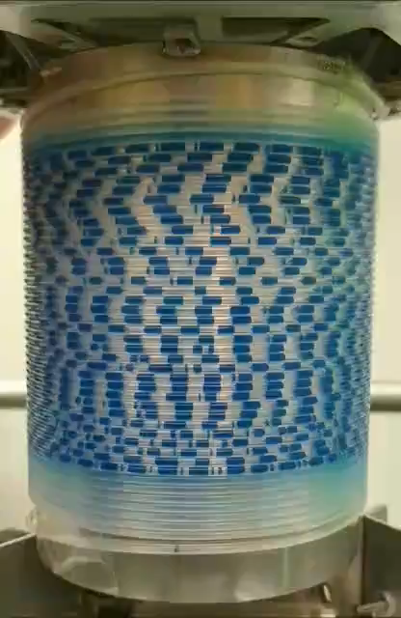
Protocol GGL reactions
1. Loop filling stock solution + alkane gas
First trial
Second trial
2. Loop filling G-L mixture + CO gas
Reaction number | Substrate | Conversion | Selectivity | Yield
FR-134-1 | Isobutane | 14.5% | 8.4% | 1.22%
FR-134-2 | Isobutane | 64.5% | 9.5% | 6%
FR-135 | Propane | 88.5% | 75% | ~60%
3. Reaction at high pressure

